Slide 1
实战

Slide 2
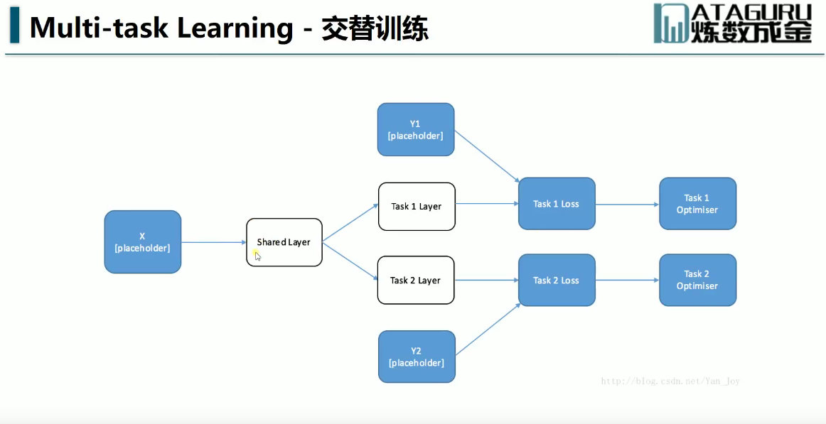
方法2

Slide 3
数组拼接方法三
思路：numpy提供了numpy.concatenate((a1,a2,...), axis=0)函数。能够一次完成多个数组的拼接。其中a1,a2,...是数组类型的参数
示例3：
>>> a=np.array([1,2,3]) >>> b=np.array([11,22,33]) >>> c=np.array([44,55,66]) >>> np.concatenate((a,b,c),axis=0) # 默认情况下，axis=0可以不写 array([ 1, 2, 3, 11, 22, 33, 44, 55, 66]) #对于一维数组拼接，axis的值不影响最后的结果
>>> a=np.array([[1,2,3],[4,5,6]]) >>> b=np.array([[11,21,31],[7,8,9]]) >>> np.concatenate((a,b),axis=0) array([[ 1, 2, 3], [ 4, 5, 6], [11, 21, 31], [ 7, 8, 9]])

Slide 4
>>> np.concatenate((a,b),axis=1) #axis=1表示对应行的数组进行拼接
array([[ 1, 2, 3, 11, 21, 31],
[ 4, 5, 6, 7, 8, 9]])

Slide 5
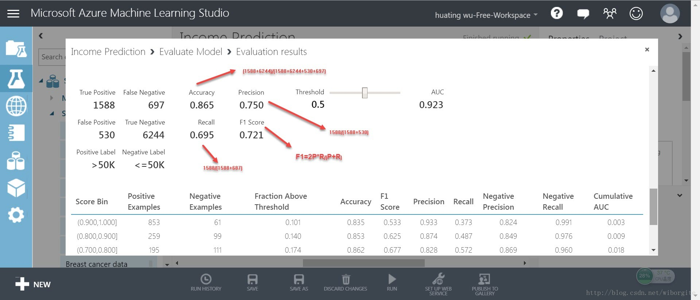
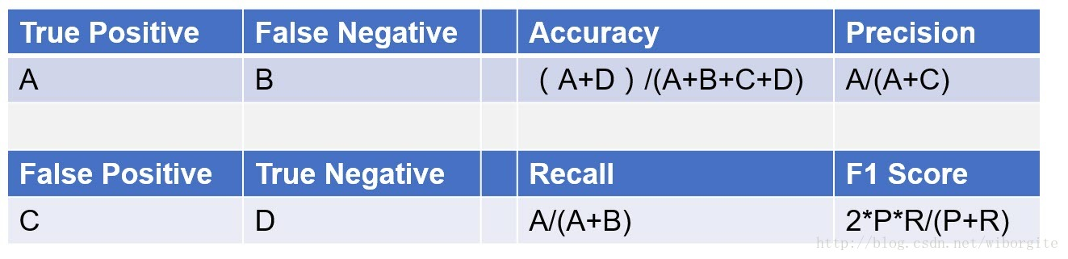

Slide 6
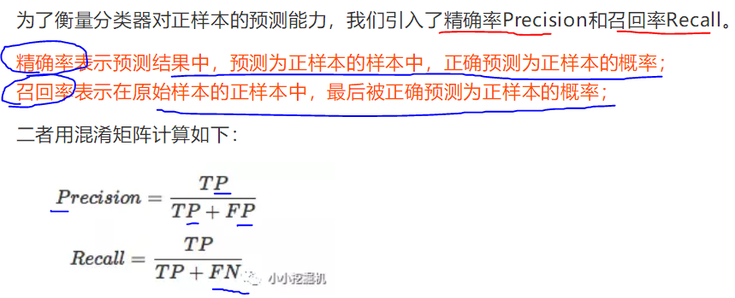

Slide 7
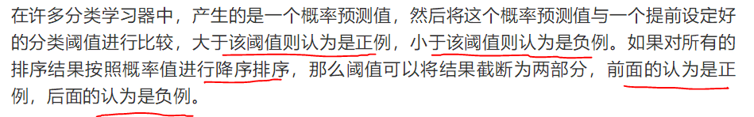
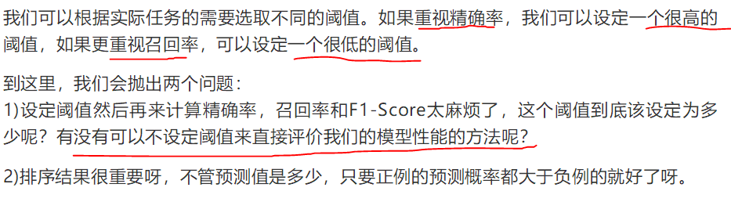
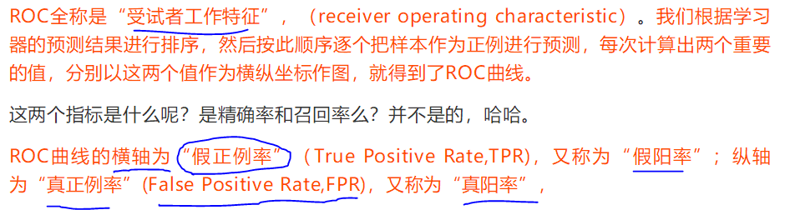
AUC

Slide 8
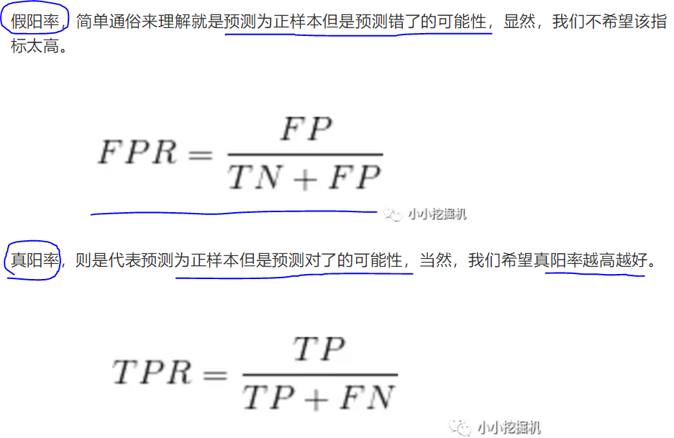
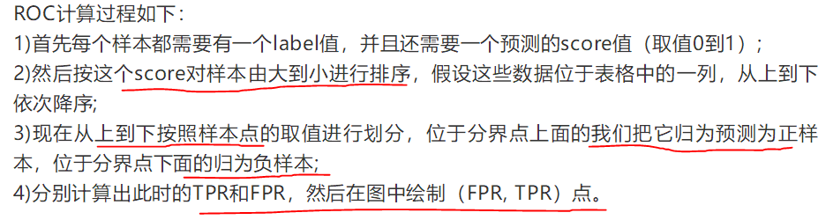

Slide 9
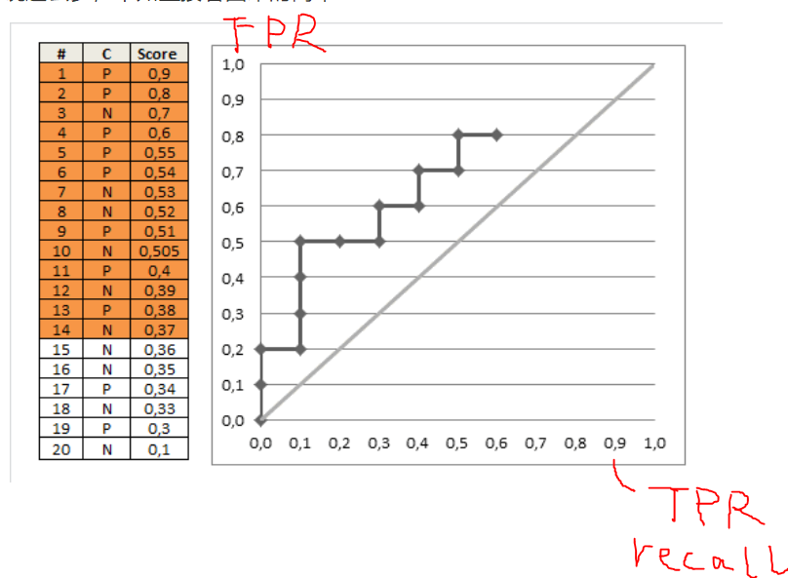

Slide 10
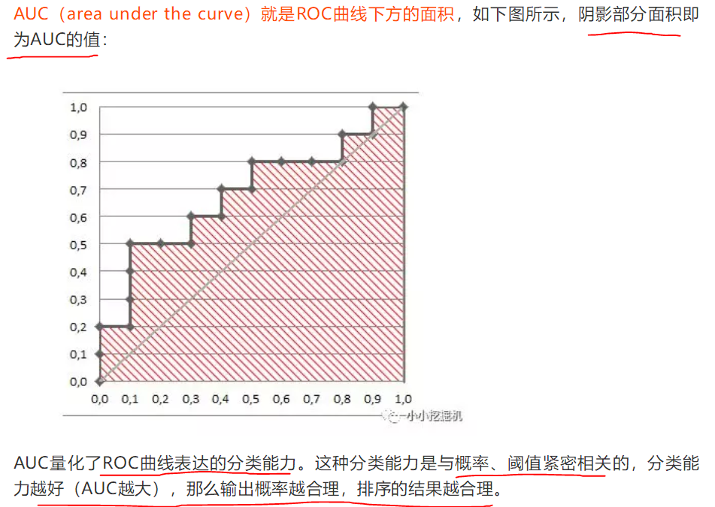
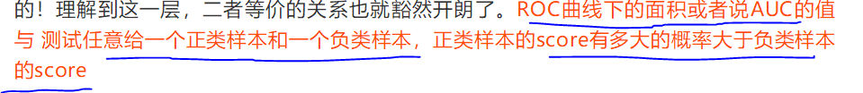

Slide 11
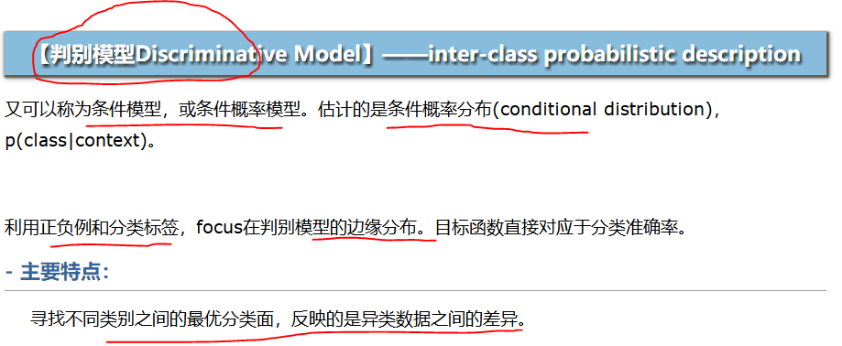
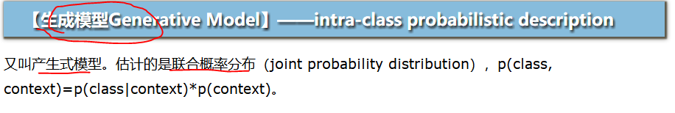
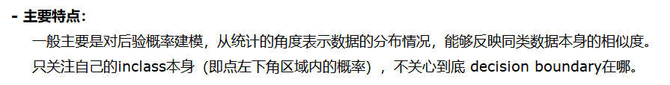
模型分类

Slide 12
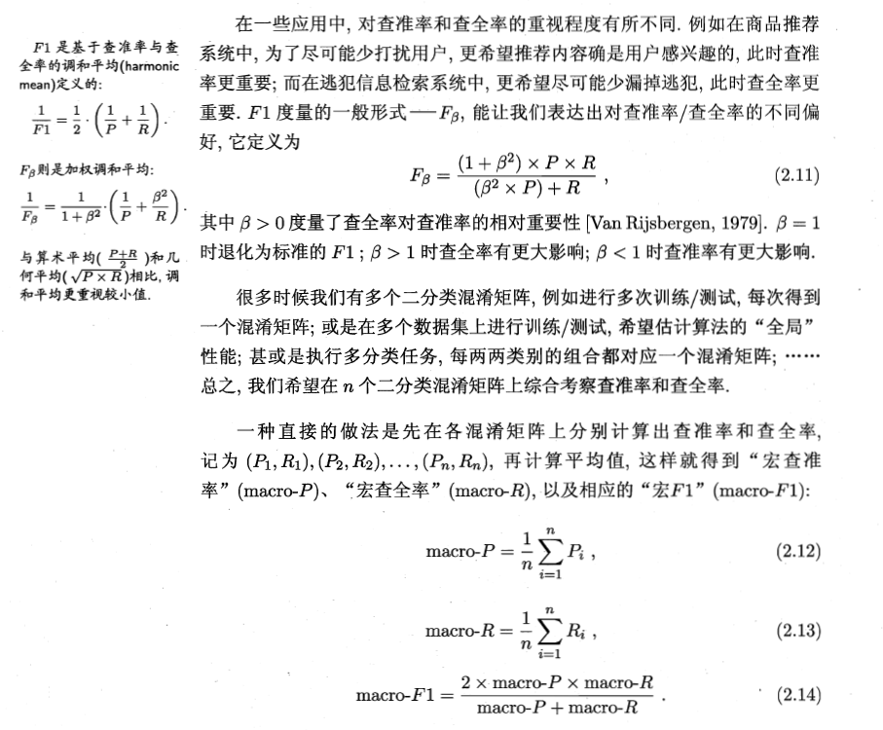
Recall

Slide 13
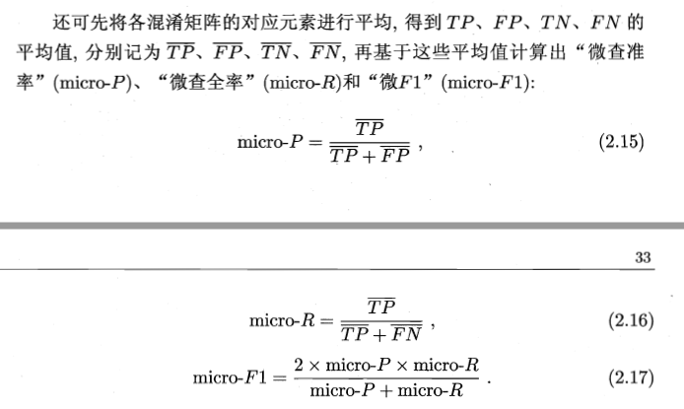
Recall and f1

Slide 14
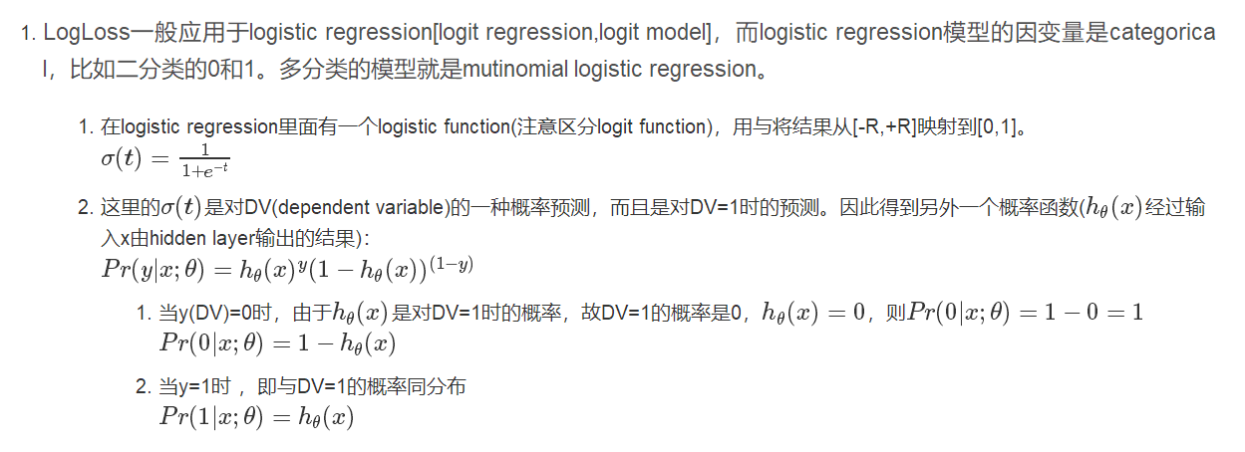
loss

Slide 15
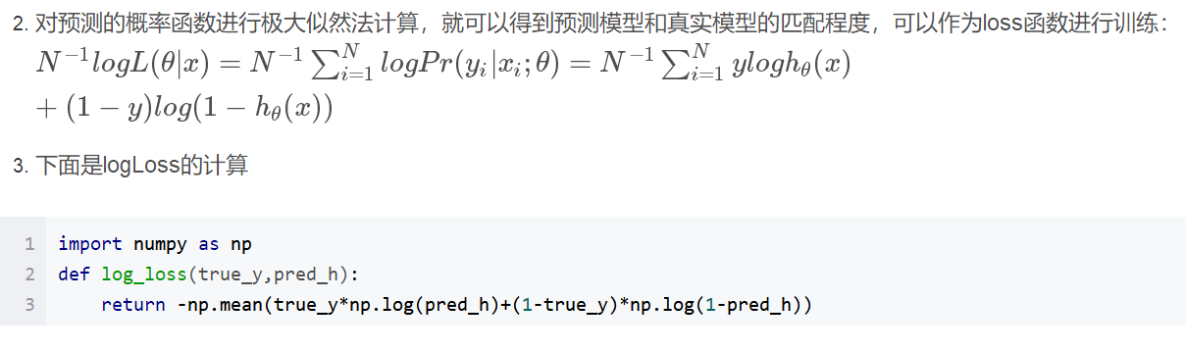
loss

Slide 17
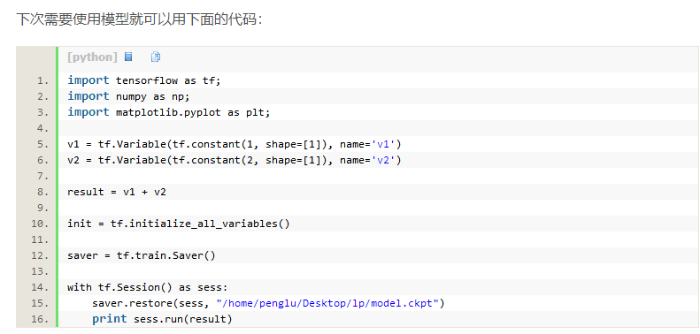

Slide 18
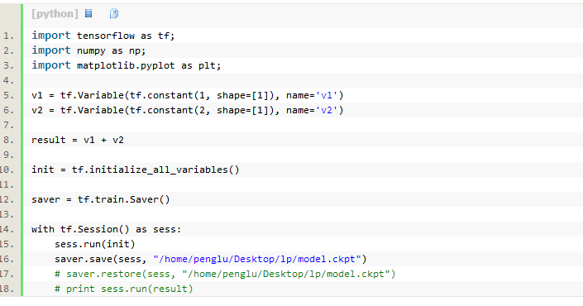

Slide 19
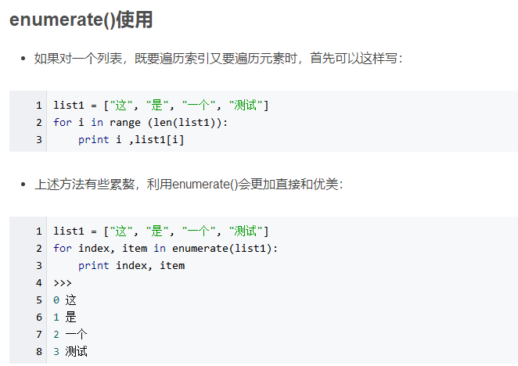

Slide 20
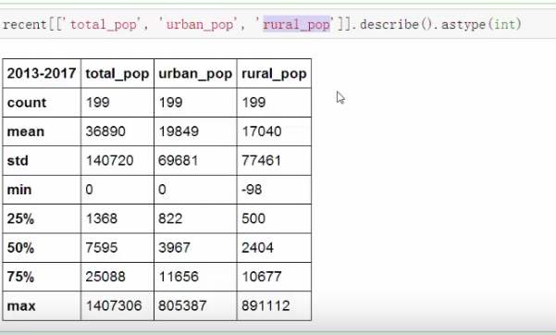

Slide 21
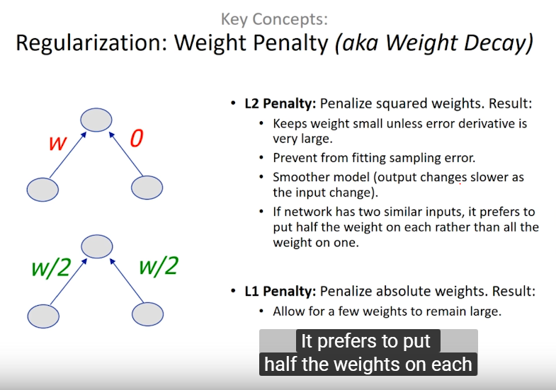

Slide 22
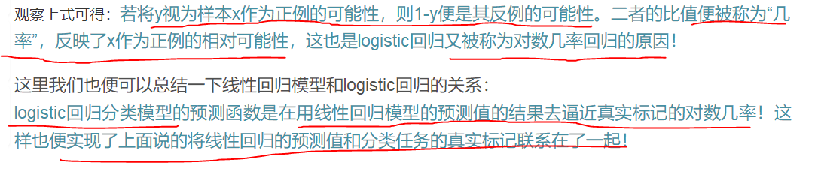
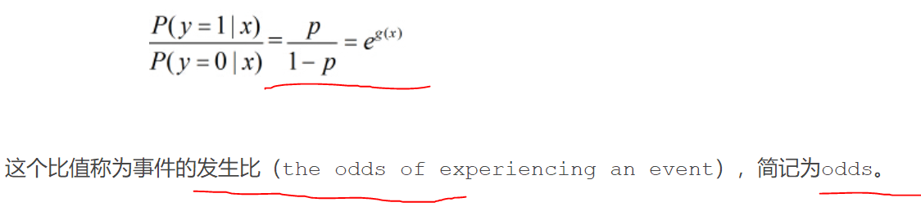
LR
https://blog.csdn.net/legendavid/article/details/79221063

Slide 23
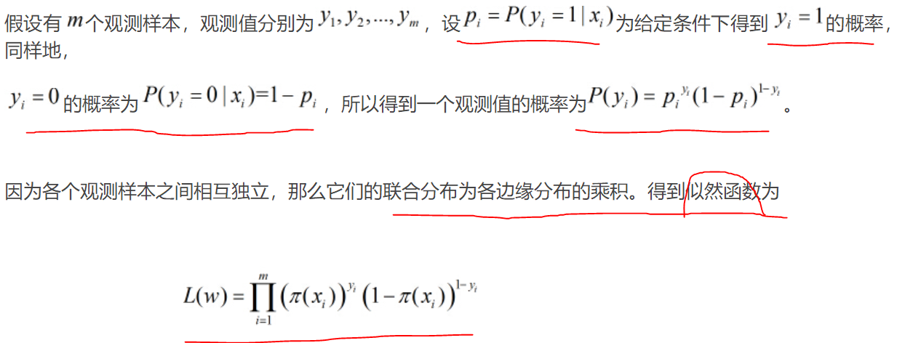
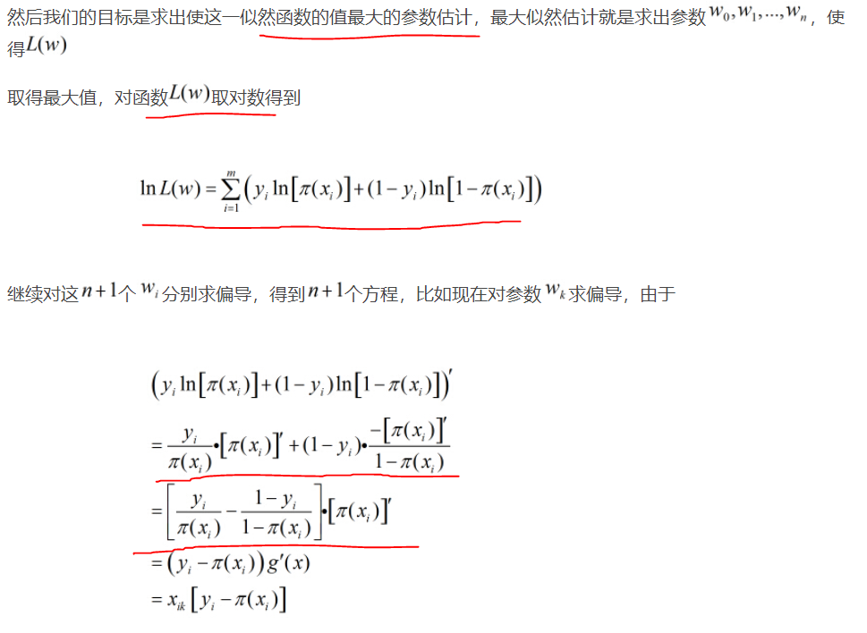
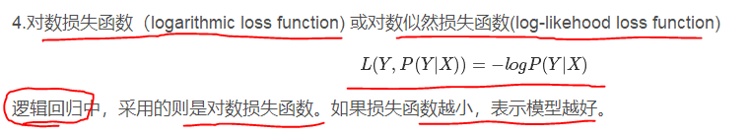
LR

Slide 24
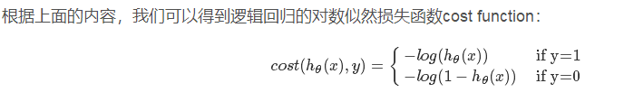
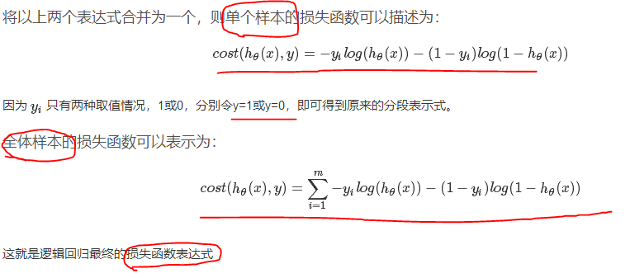
LR

Slide 25
Score
https://blog.csdn.net/matrix_space/article/details/50384518
https://mp.weixin.qq.com/s/jafC8JXHVOObMOVobu0ehw

Slide 26
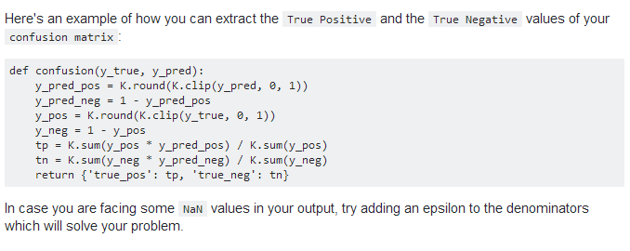

Slide 27
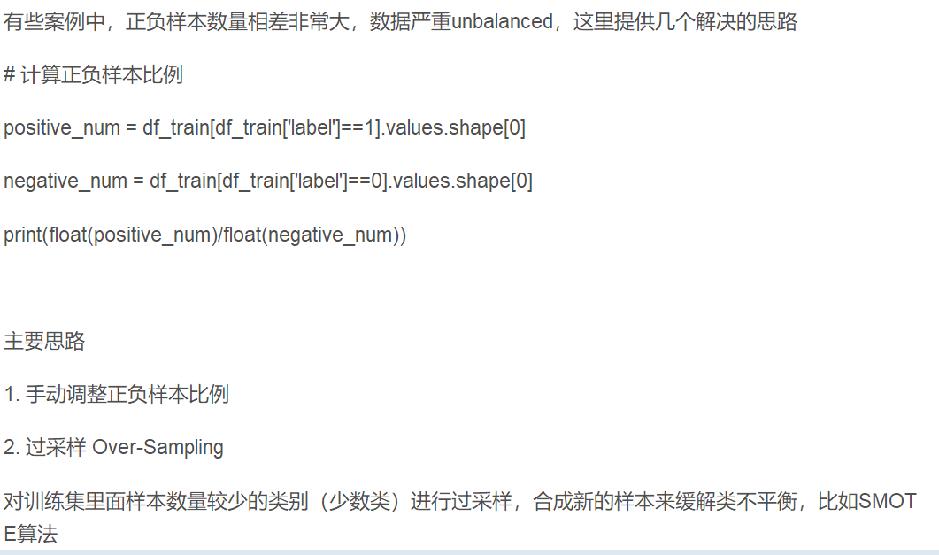
处理正负样本不均匀的案例

Slide 28
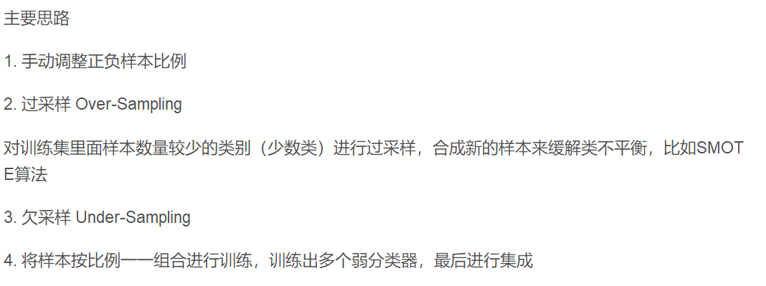

Slide 29
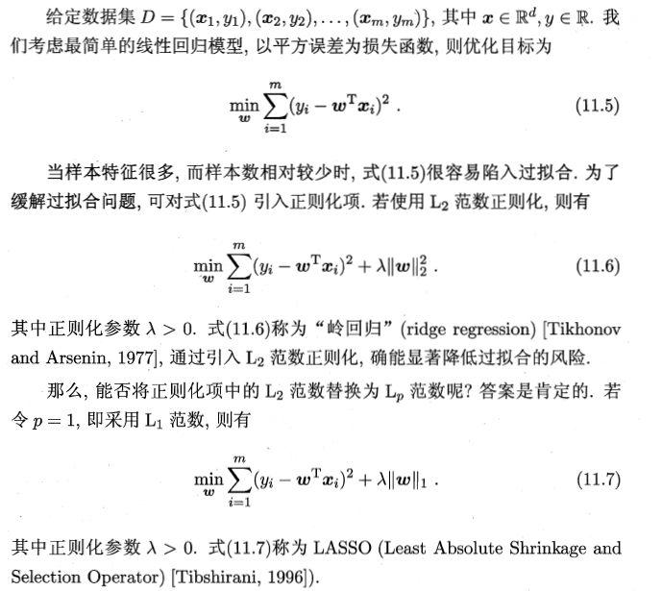
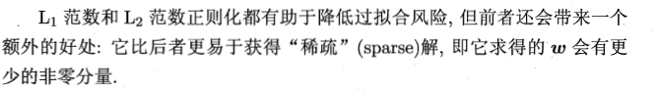
L1 L2正则

Slide 30
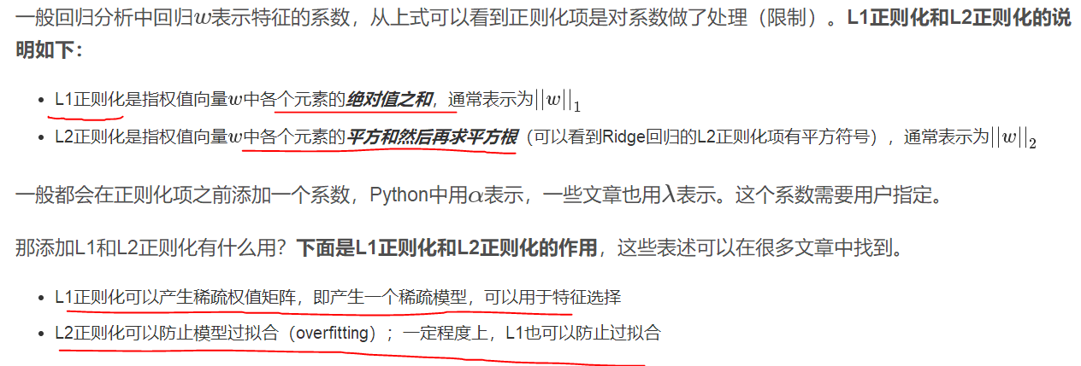
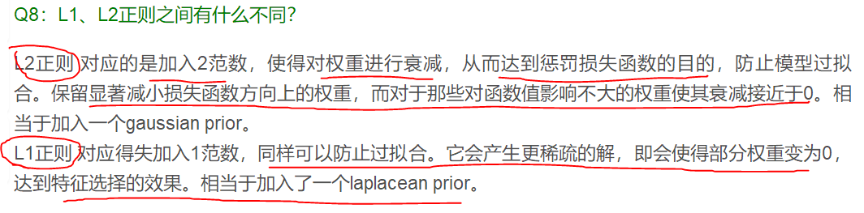
L1 L2正则

Slide 31
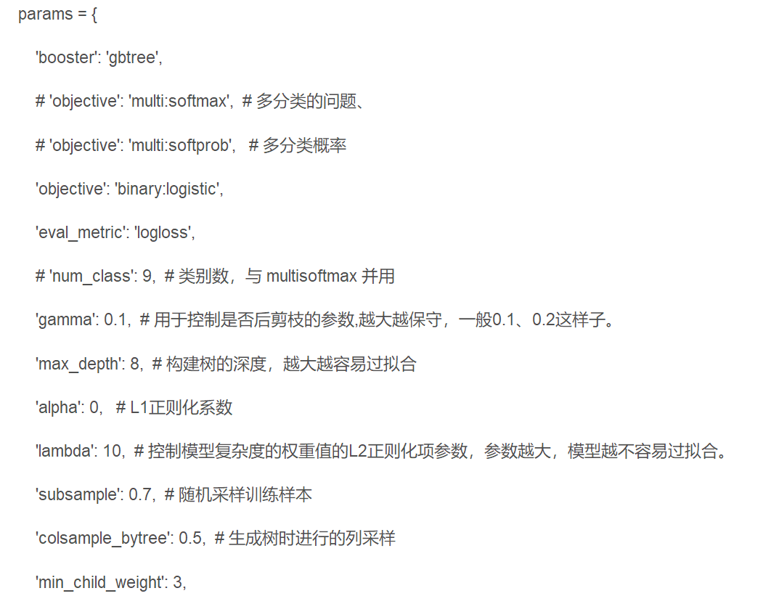
XGB LGB

Slide 32
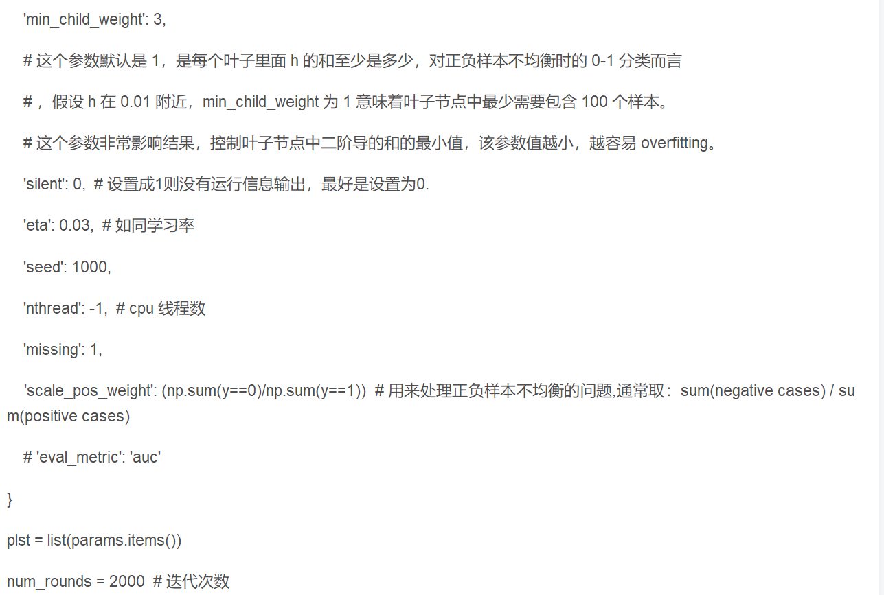
XGB LGB

Slide 33
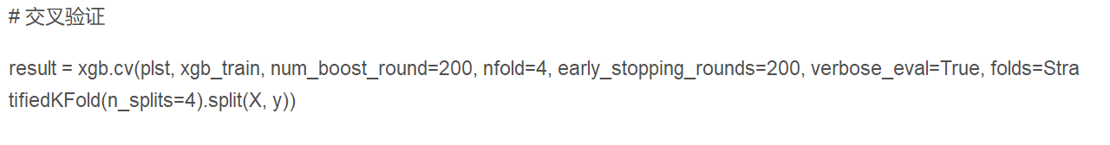
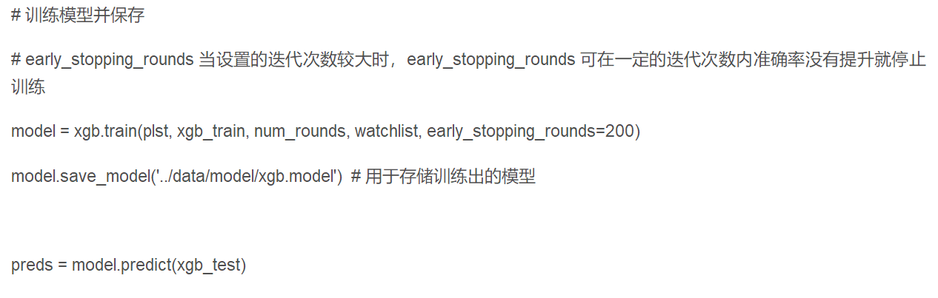

Slide 34
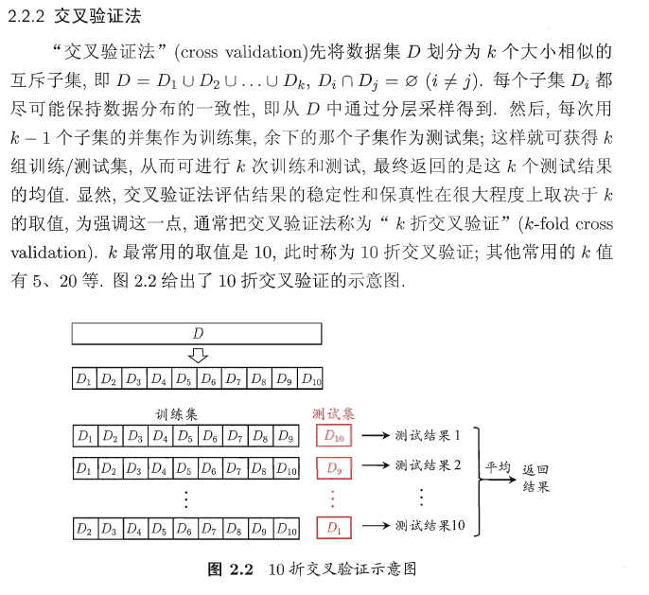
交叉验证

Slide 35
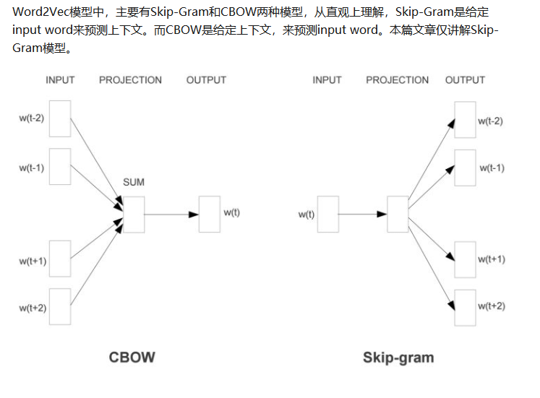
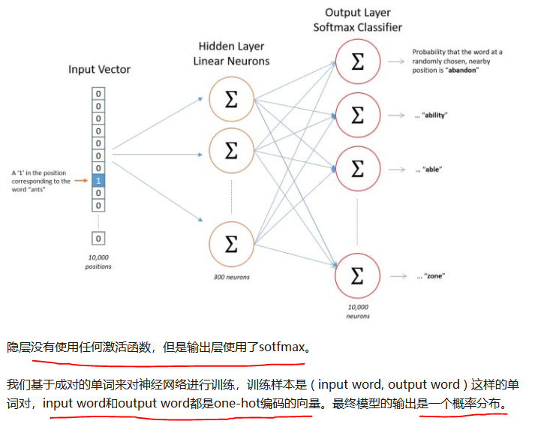
NLP

Slide 36
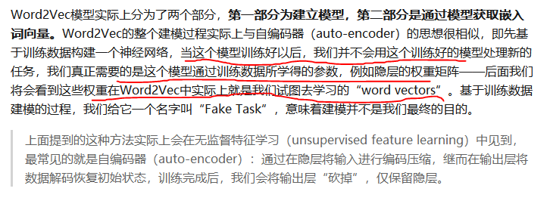
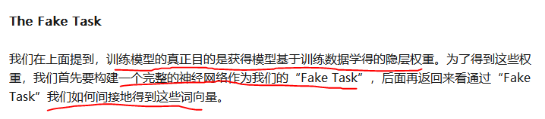

Slide 37
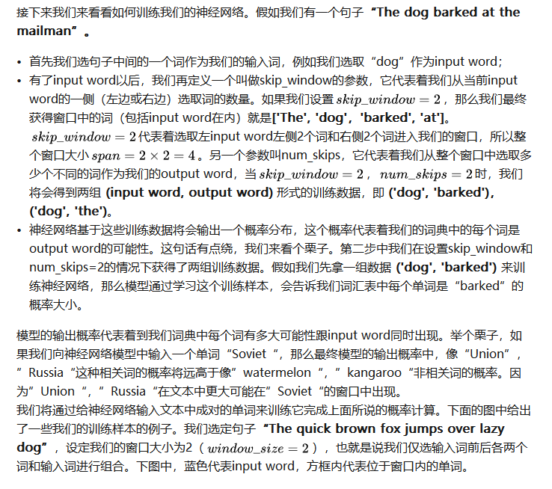
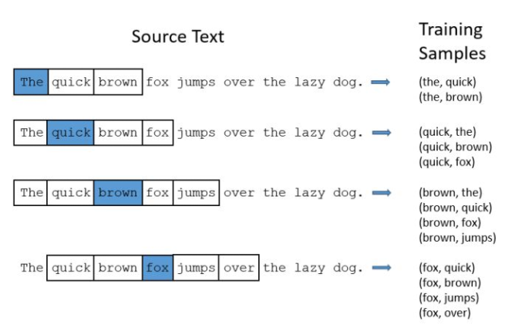

Slide 38
NLP word2vec
https://zhuanlan.zhihu.com/p/27234078?utm_source=qq&utm_medium=social&utm_oi=676471368938295296

Slide 39
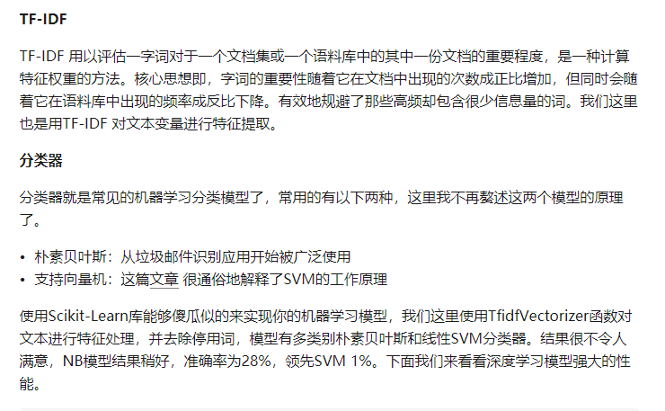

Slide 40
双向LSTM
https://blog.csdn.net/aliceyangxi1987/article/details/77094970?locationNum=7&fps=1

Slide 41

XGBOOST
https://blog.csdn.net/m_buddy/article/details/79337492

Slide 42



Bagging, boosting
https://blog.csdn.net/wangqi880/article/details/49765673
https://www.cnblogs.com/earendil/p/8872001.html

Slide 43


Bagging, boosting

Slide 44


GBDT 原理
https://www.cnblogs.com/ScorpioLu/p/8296994.html

Slide 45

GBDT

Slide 46


GBDT

Slide 47

GBDT

Slide 48

GBDT

Slide 49


GBDT

Slide 50


GBDT

Slide 51

GBDT

Slide 52

GBDT
https://www.cnblogs.com/pinard/p/6140514.html 搞懂这个

Slide 53

GBDT Adaboost

Slide 54

XGBOOST and GBDT

Slide 55

随机森林

Slide 56


决策树和cart树

Slide 57



Cart树

Slide 58
决策树

Slide 59
SVD
https://www.cnblogs.com/pinard/p/6251584.html

Slide 60



LDA 降维
LDA
https://www.cnblogs.com/pinard/p/6244265.html
PCA
http://www.cnblogs.com/pinard/p/6239403.html

Slide 61


PCA 降维

Slide 62
GBDT
https://www.cnblogs.com/pinard/p/6140514.html

Slide 63
集成学习
https://www.cnblogs.com/pinard/p/6131423.html

Slide 64
ADABOOST
https://www.cnblogs.com/pinard/p/6133937.html

Slide 65



偏差与方差

Slide 66

dropout
https://mp.weixin.qq.com/s?__biz=MzI5NDMzMjY1MA==&mid=2247484411&idx=1&sn=b4ff1f0fb05902b285134ef56b3ca091&chksm=ec65327edb12bb68731331237887cb1988b928207e3e98c83c79a0bbf19a1fed706d84409161&mpshare=1&scene=23&srcid=0618rxgjCD97g39O9YrhjK1N#rd

Slide 67

样本不平衡（西瓜书66）

Slide 68

样本不平衡

Slide 69

样本不平衡

Slide 70

样本不平衡

Slide 71

SVM
https://mp.weixin.qq.com/s/n731WPpYhJAG6CmoKN2Hig

Slide 72

SVM

Slide 73


SVM

Slide 74

SVM

Slide 75


KNN 聚类

Slide 76


K-MEANS

Slide 77
EM 算法

Slide 78

感知器

Slide 79
LR 推导

Slide 80


cross entropy loss

Slide 81

cross entropy loss

Slide 82


Softmax 和cross entropy

Slide 83

Softmax 和cross entropy

Slide 84
LSTM 记忆结构和CNN

Slide 85
强特征的选择

Slide 86


Slide 87

贝叶斯

Slide 88


向量乘积
https://blog.csdn.net/dcrmg/article/details/52416832

Slide 89


向量内积

Slide 90





防止过拟合

Slide 91




Slide 92

Batch normalization

Slide 93

梯度下降

Slide 94


Attention net

Slide 95

Attention net

Slide 96





Slide 97


Slide 98



健康 AI

Slide 99

健康 AI

Slide 100


协同过滤

Slide 101




Slide 102



Slide 103



Slide 104



Slide 105


Slide 106



Slide 107



Slide 108



Slide 109



Slide 110



Slide 111



Slide 112




Slide 113


Slide 117
数学推导
LR
XGBOOST / GBDT
BP
Q learning

